Slide 1


Slide 2
200.6 Neutral Conductor Identification
Revisions to the requirements for marking neutral conductors have been made.

Slide 3
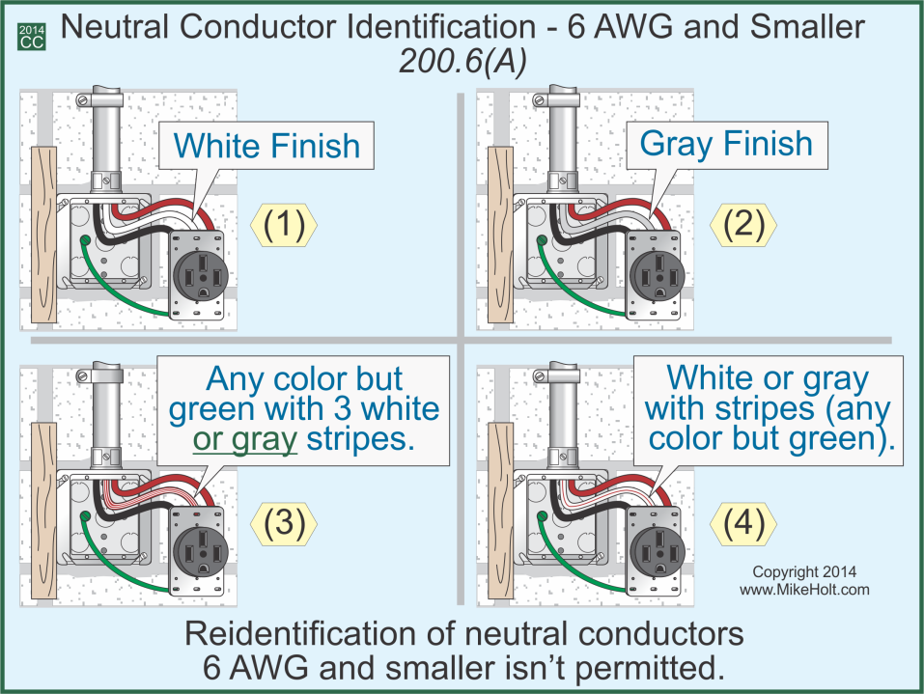

Slide 4
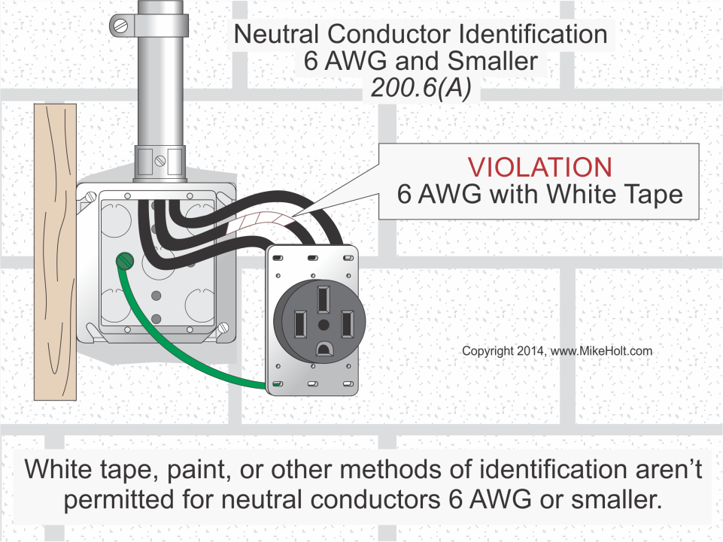

Slide 5
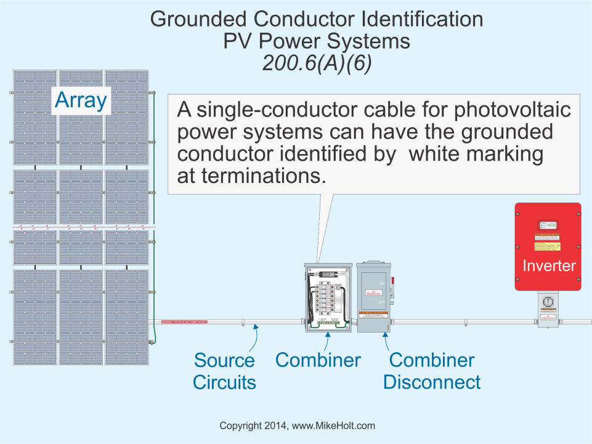
Must have remove extra space

Slide 6
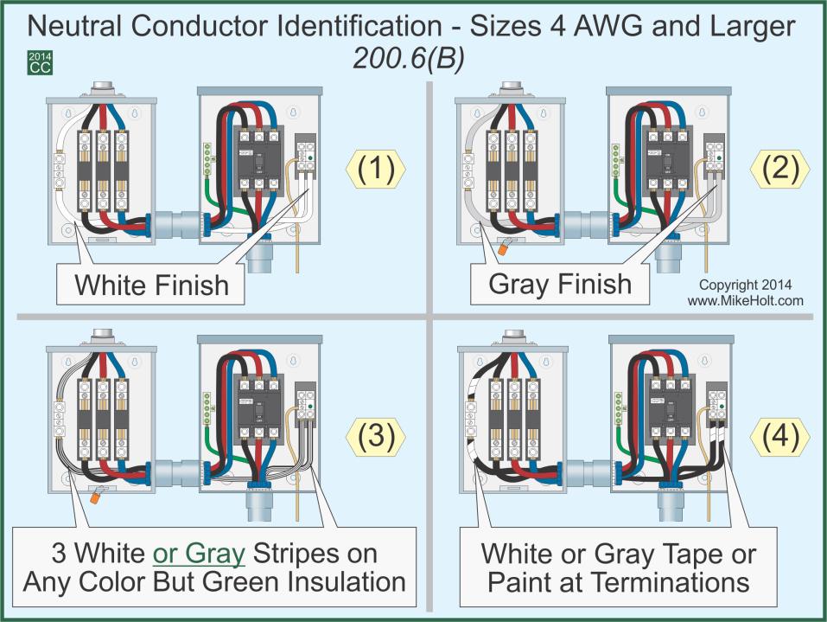

Slide 7
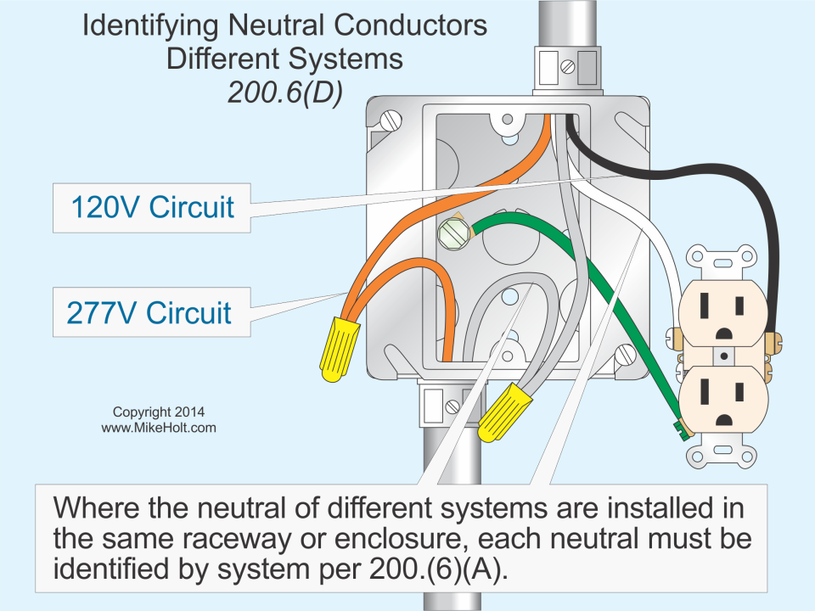

Slide 8
