Slide 1


Slide 2
300.1 Scope
The requirements contained in Article 300 don’t apply to signaling and communications systems, except where referenced in Chapter 7 or 8.
  Class 2 and 3 Circuits, 725.3
  Communications, 800.3
  Fire Alarm Circuits, 760.3

Slide 3
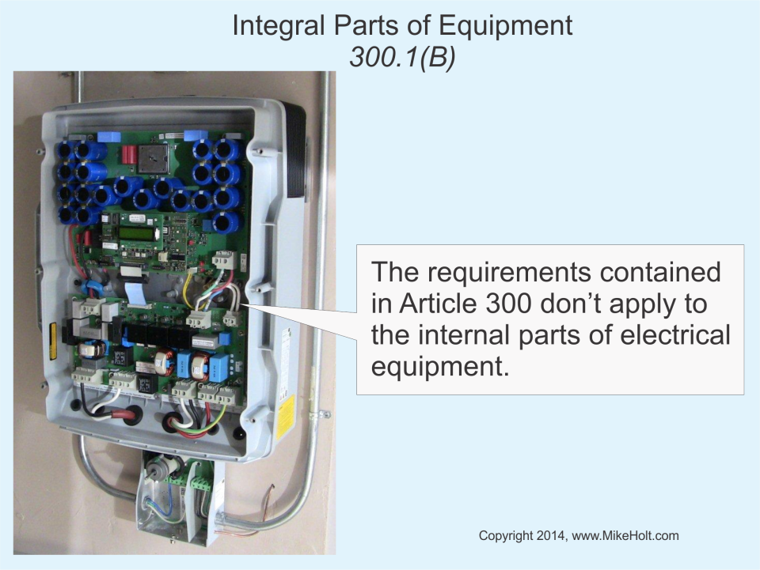

Slide 4
300.3 Conductors

Slide 5
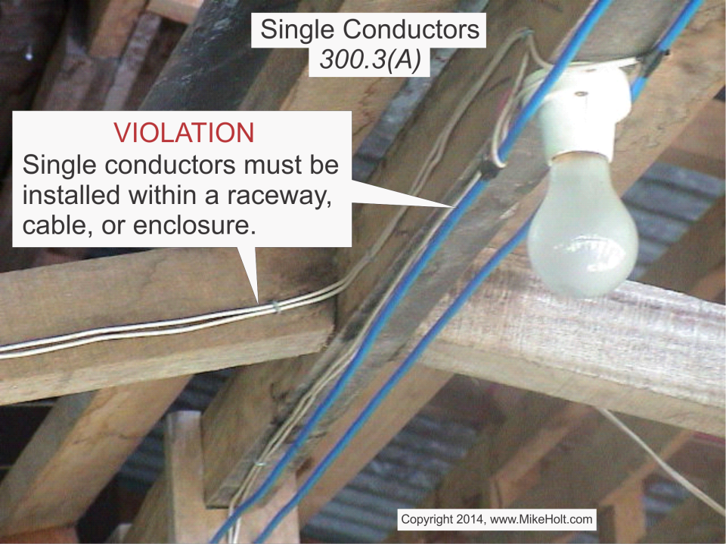

Slide 6
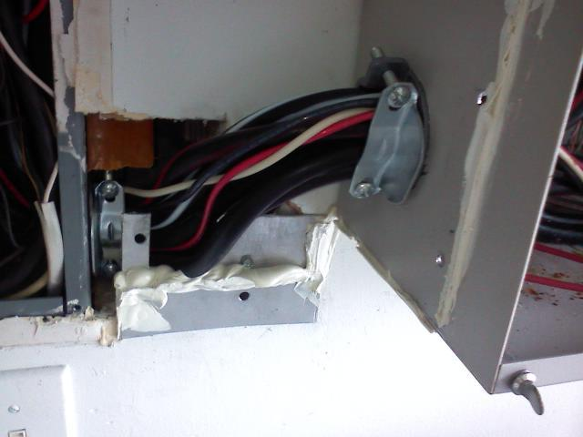


Slide 7
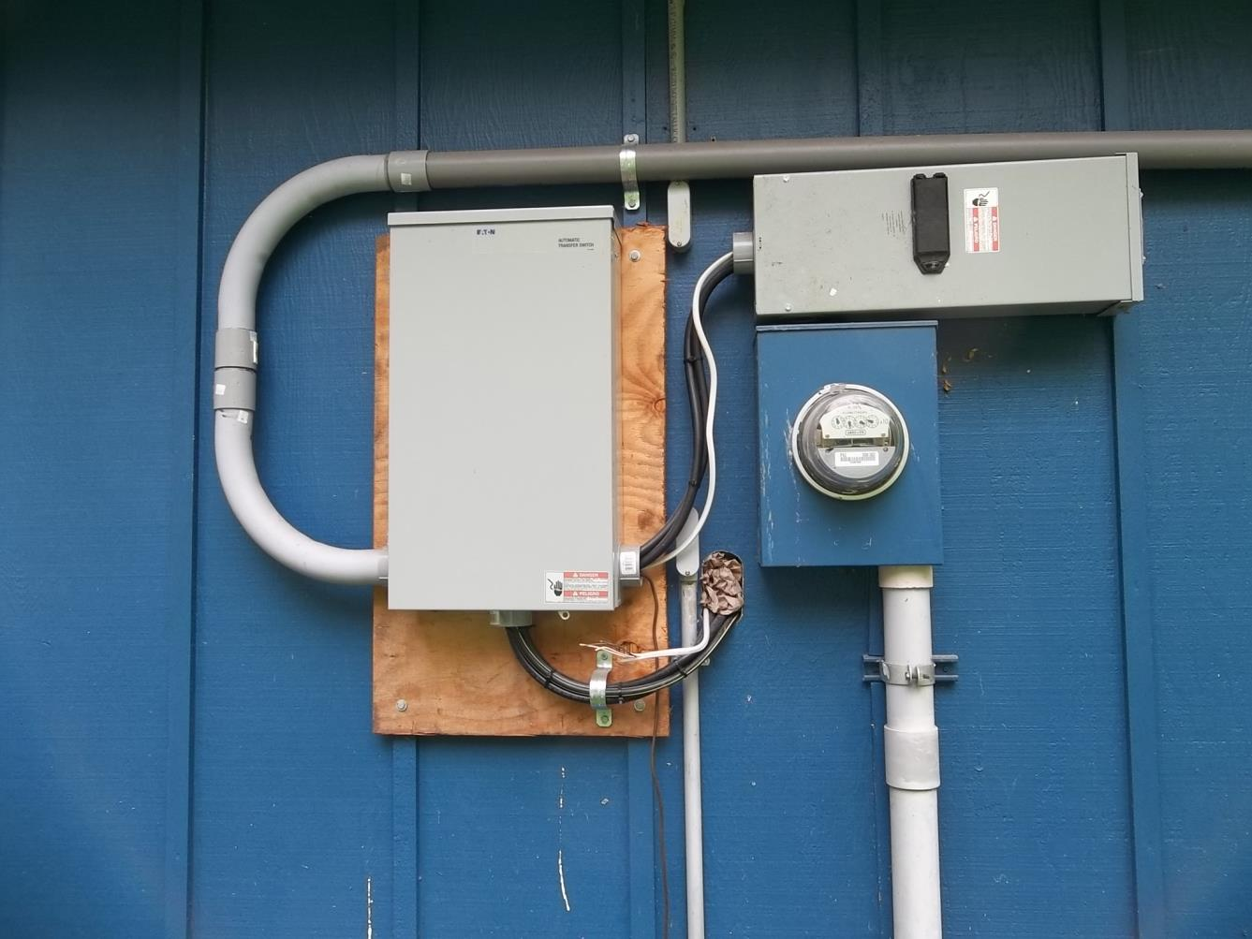

Slide 8
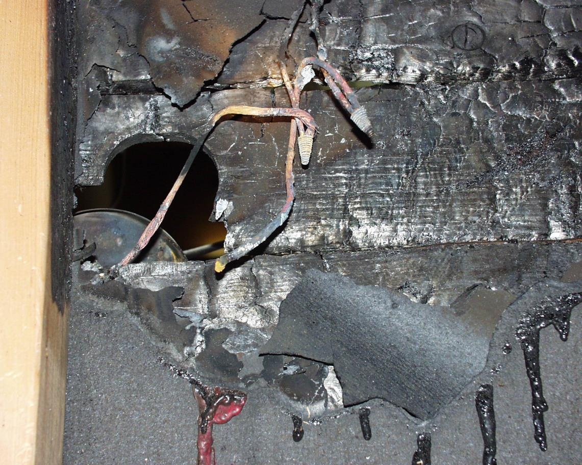

Slide 9
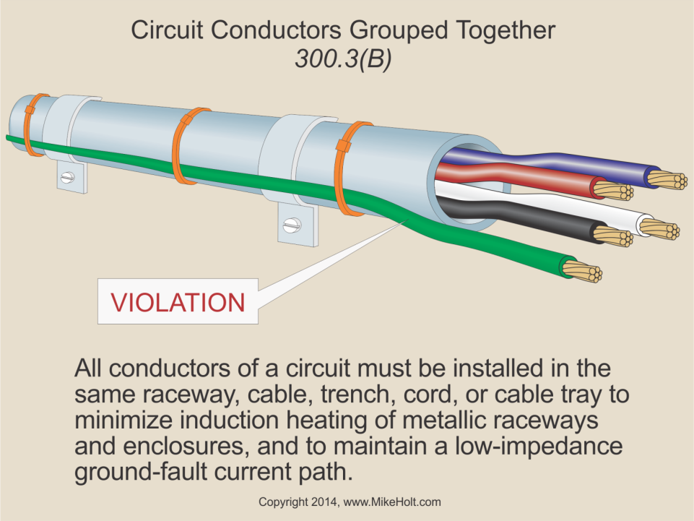

Slide 10
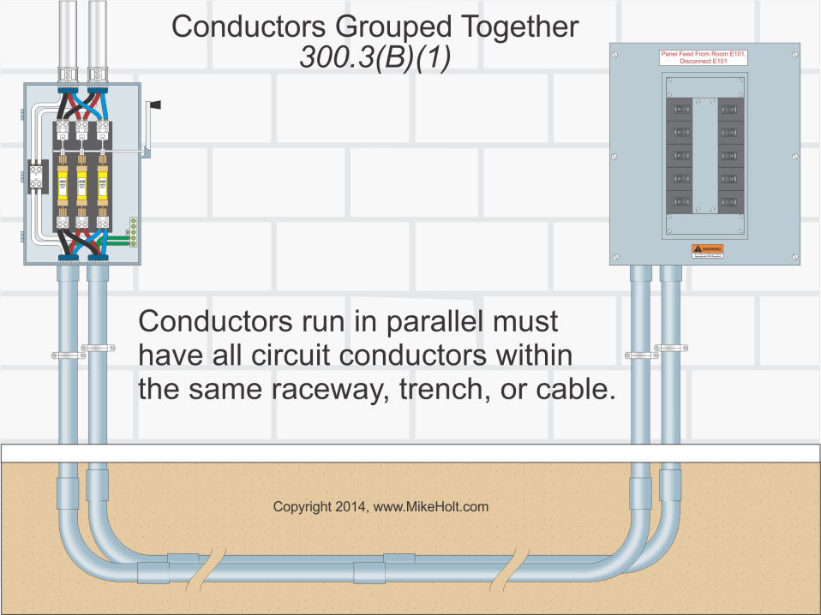

Slide 11
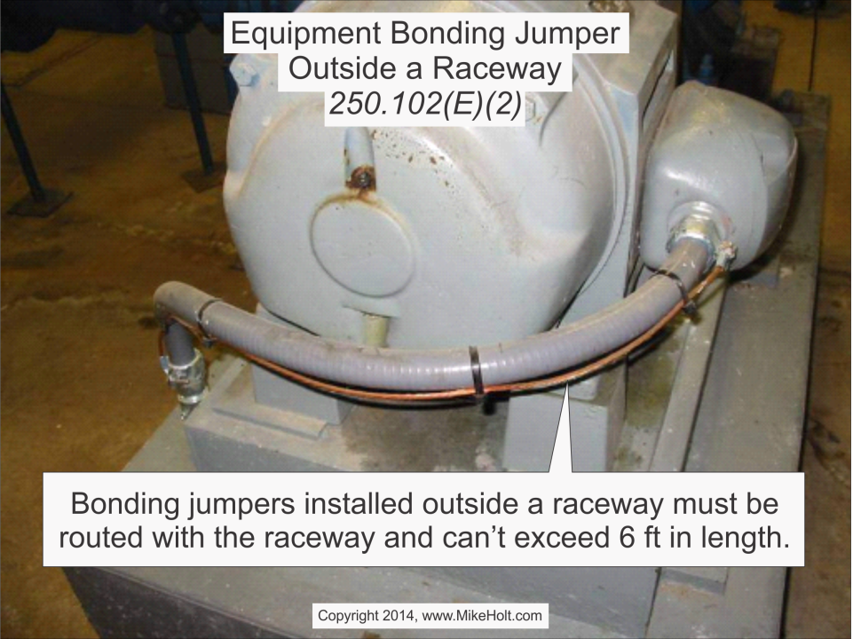

Slide 12
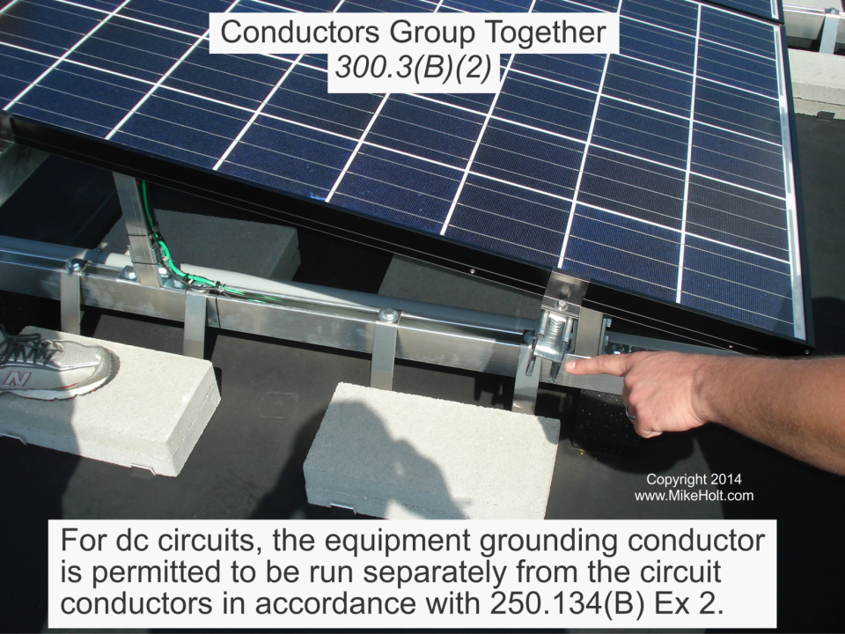

Slide 13
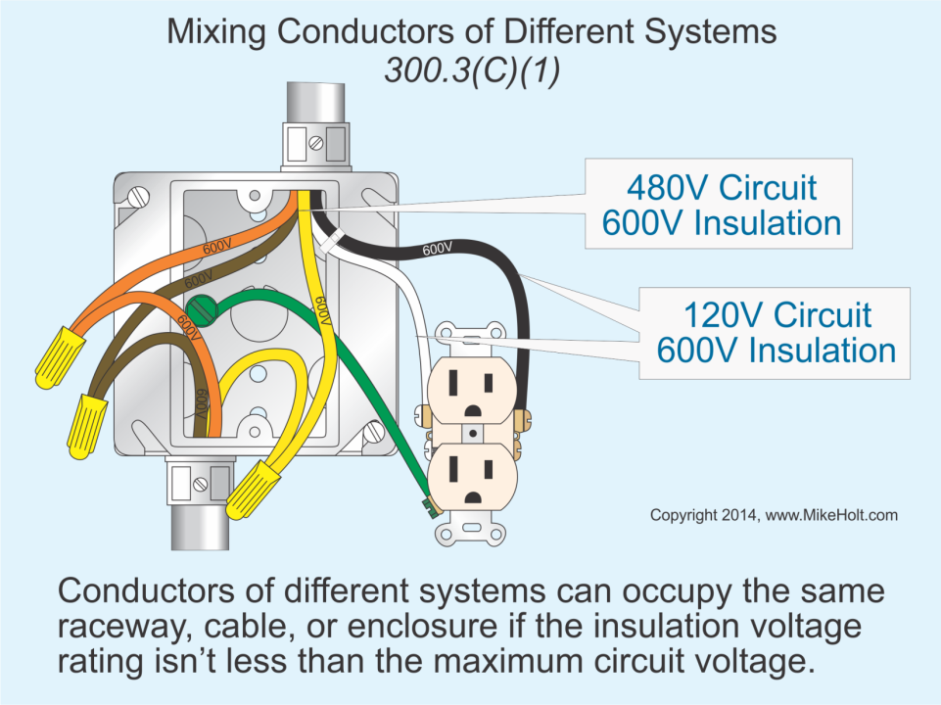

Slide 14
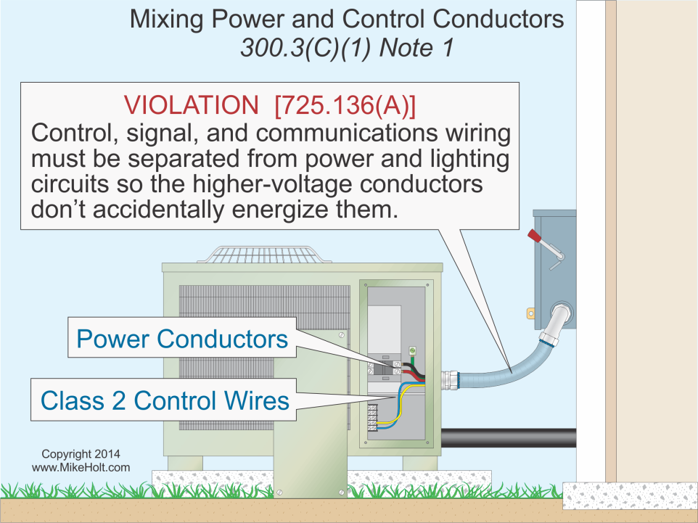

Slide 15
