Slide 1

Article 210—Branch Circuits
Notes:
** **

Slide 2
GFCI Protection
210.8
Revisions are many and include clarifications, expansions to existing rules, and a few new items.
Notes:
**There is absolutely no doubt that ground-fault circuit-interrupter protection has done more than its fair share of protecting people from the hazards involved with the use of electricity. Each Code cycle increases the emphasis on GFCI protection and the locations in which they are required. With so much attention given to this section, it is inevitable that all circuits in dwelling units will eventually require this protection. The 2020 changes and revisions to this article are indeed numerous and include clarifications, expansions to existing rules, and a few new additional items. Some items were relocated and placed in their appropriate articles as indicated in the Informational Notes.
So much revision requires the extensive that follows:
**

Slide 3
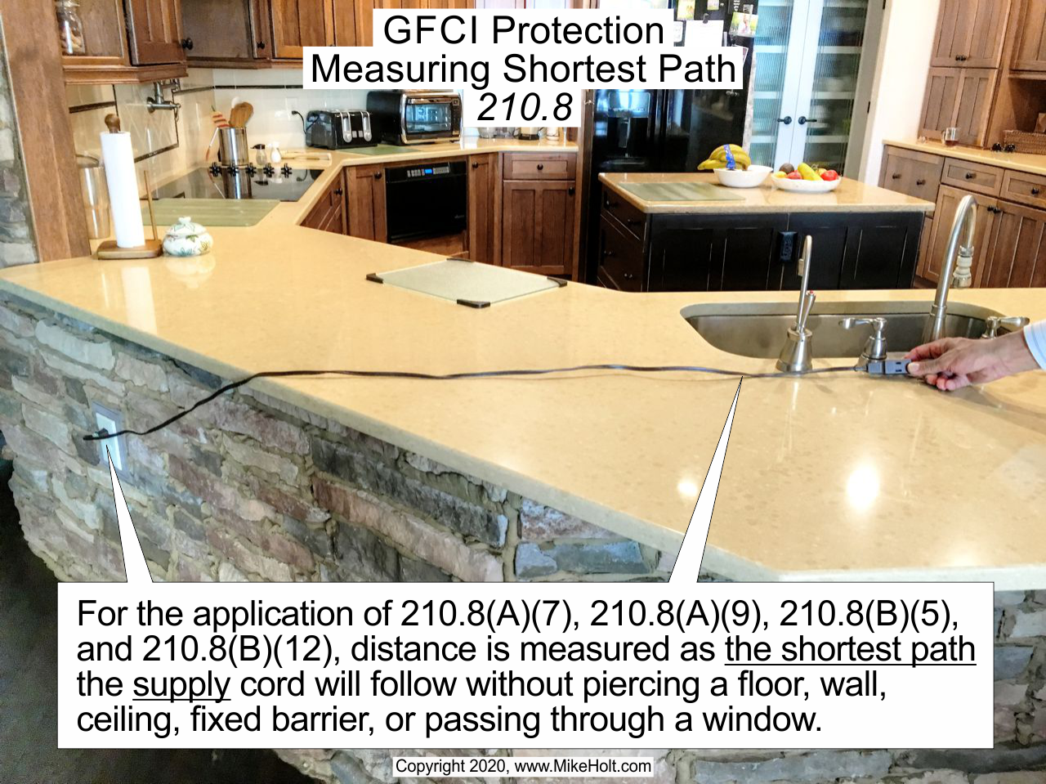
Notes:
~~210.8 02 PH.png~~
{{ FileDate: 10/9/2019 9:49:00 AM
ScriptLastRun: 10/10/2019 10:18:01 AM
DO NOT EDIT TEXT BETWEEN BRACKETS }}

Slide 4
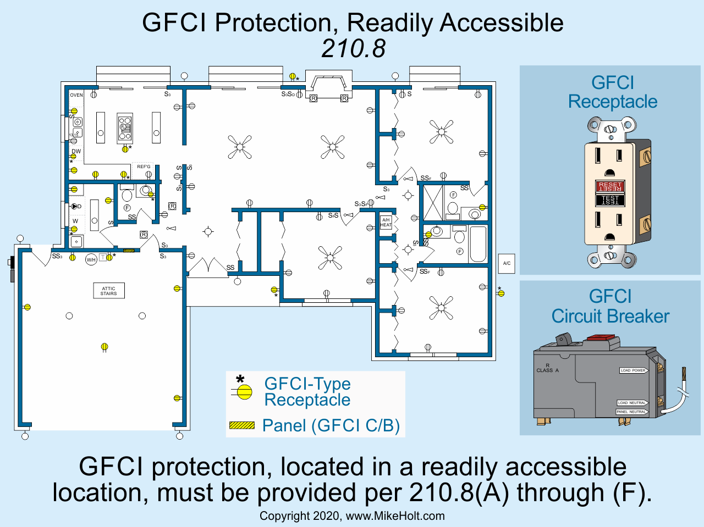
Notes:
~~210.8 01.png~~
{{ FileDate: 10/9/2019 9:48:58 AM
ScriptLastRun: 10/10/2019 10:18:01 AM
DO NOT EDIT TEXT BETWEEN BRACKETS }}

Slide 5
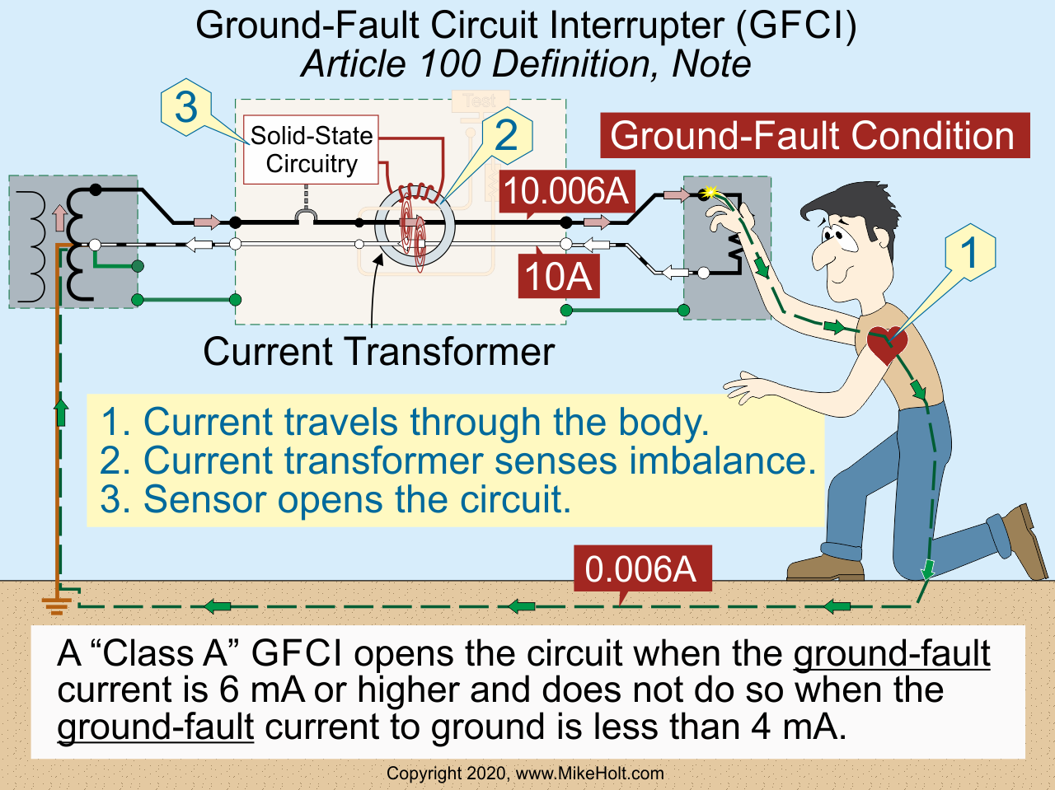
Notes:
~~100-ground-fault CI 01 N0.png~~
{{ FileDate: 10/9/2019 9:40:17 AM
ScriptLastRun: 10/10/2019 10:18:01 AM
DO NOT EDIT TEXT BETWEEN BRACKETS }}

Slide 6
Dwelling Units
210.8(A)
Requirements were expanded for GFCI protection of receptacles rated 125V through 250V.

Slide 7
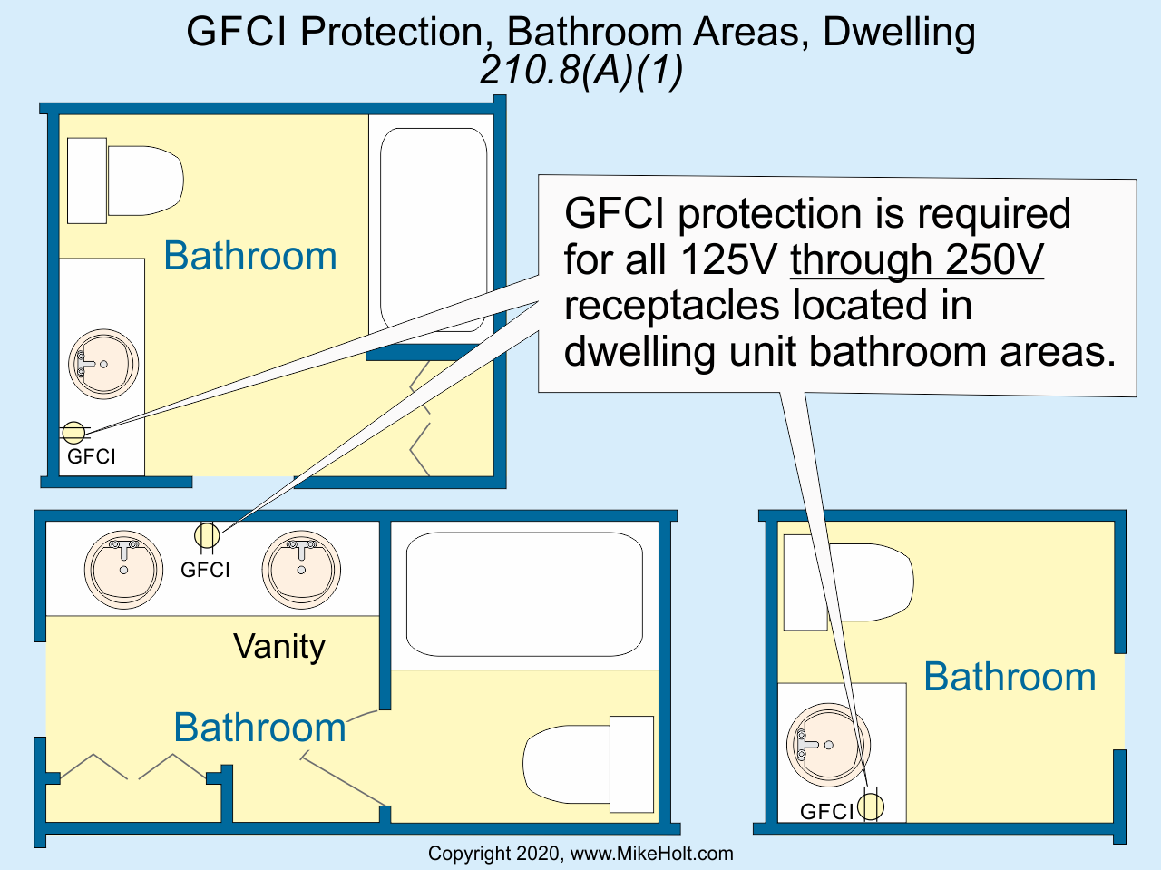
Notes:
~~210.8A1 01.png~~
{{ FileDate: 10/9/2019 9:49:02 AM
ScriptLastRun: 10/10/2019 10:18:01 AM
DO NOT EDIT TEXT BETWEEN BRACKETS }}

Slide 8
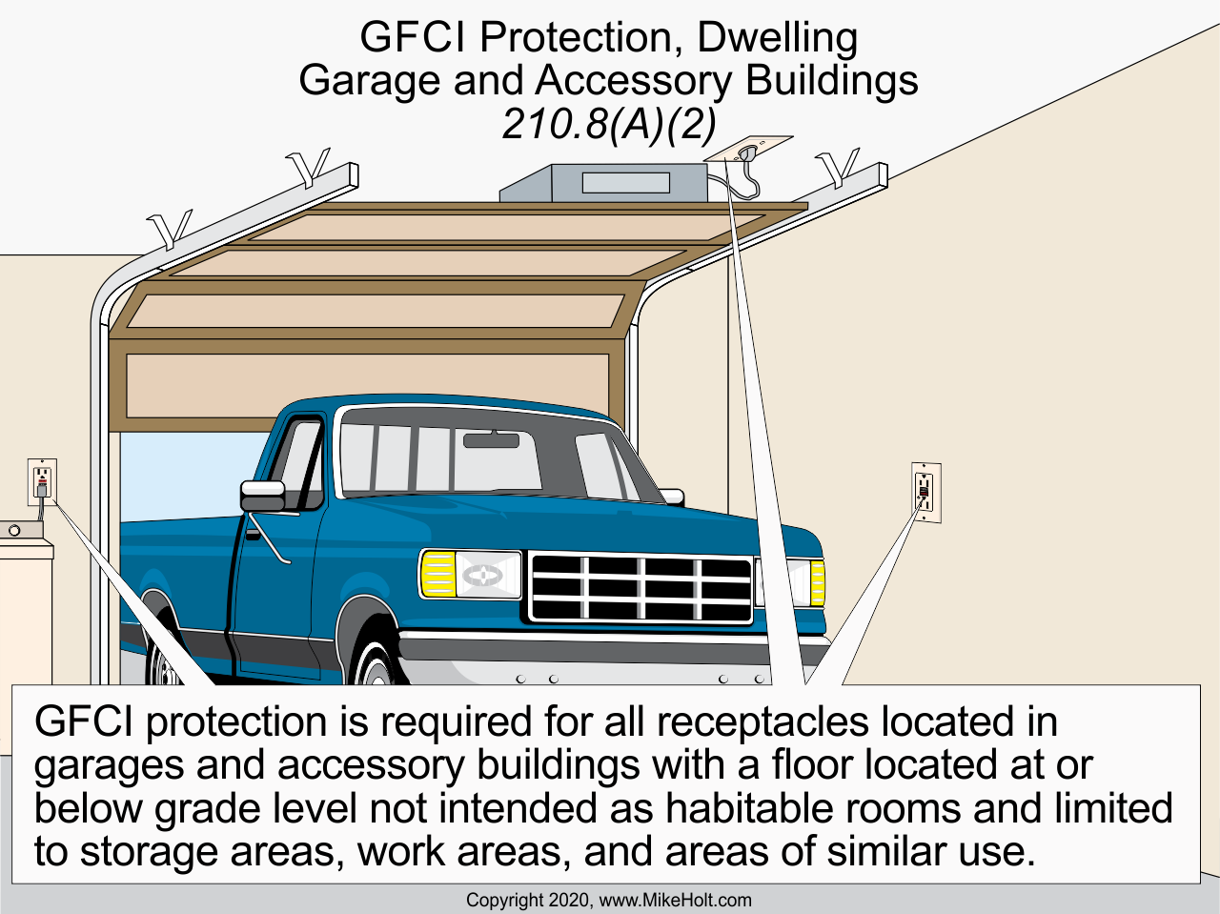
Notes:
~~210.8A2 01.png~~
{{ FileDate: 10/9/2019 9:49:04 AM
ScriptLastRun: 10/10/2019 10:18:01 AM
DO NOT EDIT TEXT BETWEEN BRACKETS }}

Slide 9
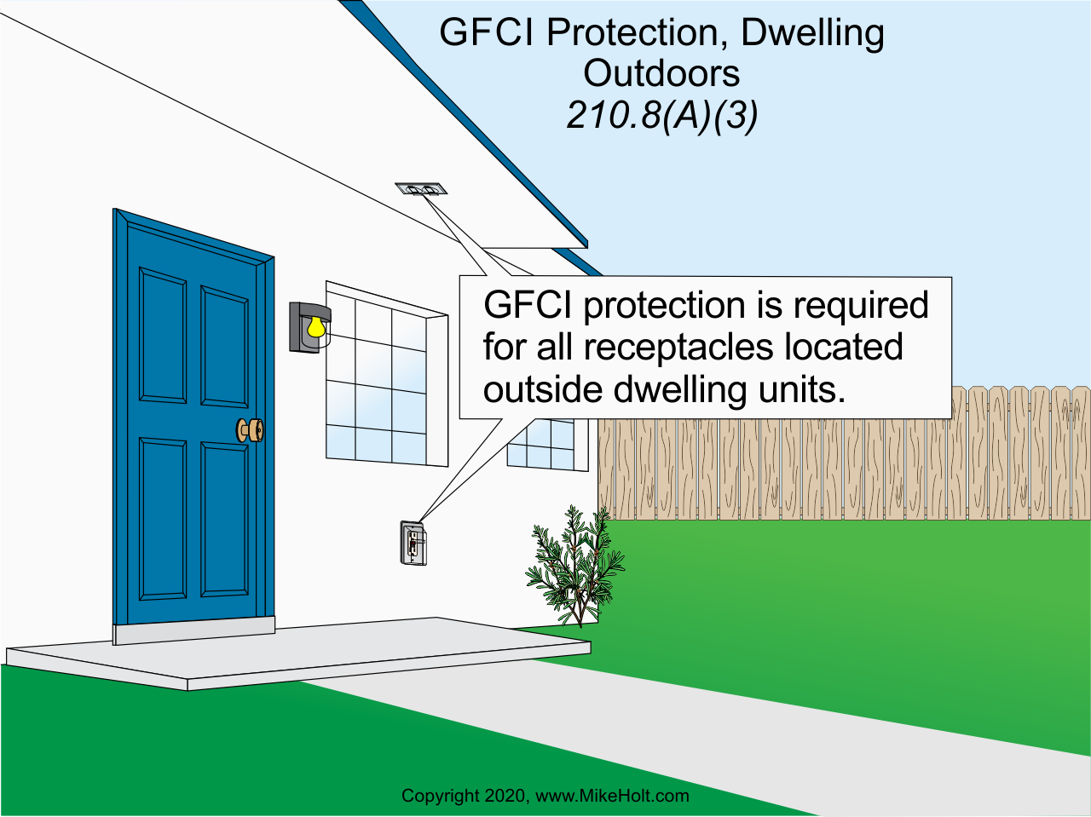
Notes:
~~210.8A3 01.png~~
{{ FileDate: 10/9/2019 9:49:05 AM
ScriptLastRun: 10/10/2019 10:18:01 AM
DO NOT EDIT TEXT BETWEEN BRACKETS }}

Slide 10
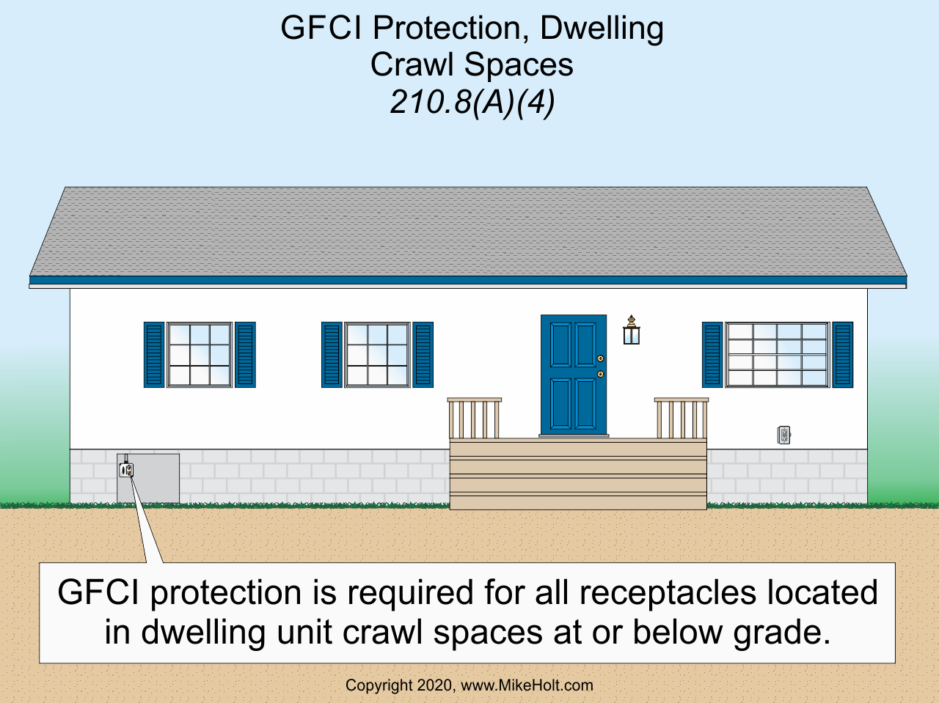
Notes:
~~210.8A4 01.png~~
{{ FileDate: 10/9/2019 9:49:09 AM
ScriptLastRun: 10/10/2019 10:18:01 AM
DO NOT EDIT TEXT BETWEEN BRACKETS }}

